Slide 1

FORAGE - TATA Data Visualisation
SIVA AANANDHI R

Slide 2


INTRODUCTION
TASK
STEPS DONE
The task is to analyse, interpret insights and to display visual diagrams for an online retail store data.
The dataset was cleaned by removing null values and negative entries.

Slide 3
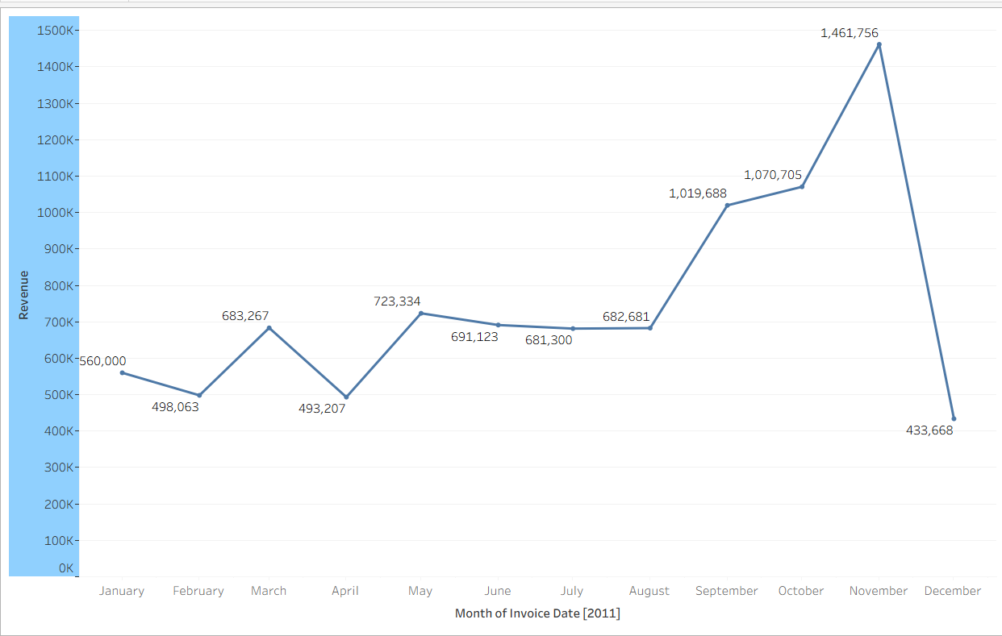
TASK 1
2011 REVENUE DATA
“
Viewing the time series of the revenue for the year 2011 only. For this I have used line chart that shows the each month revenue for the year 2011. This chart might be useful in finding trends and helping predict next year sales.
.
Key points:
The data visualisation diagram used is line chart.
The month was alone extracted for the year 2011.
The december fall depicts the seasonality affecting sales.

Slide 4
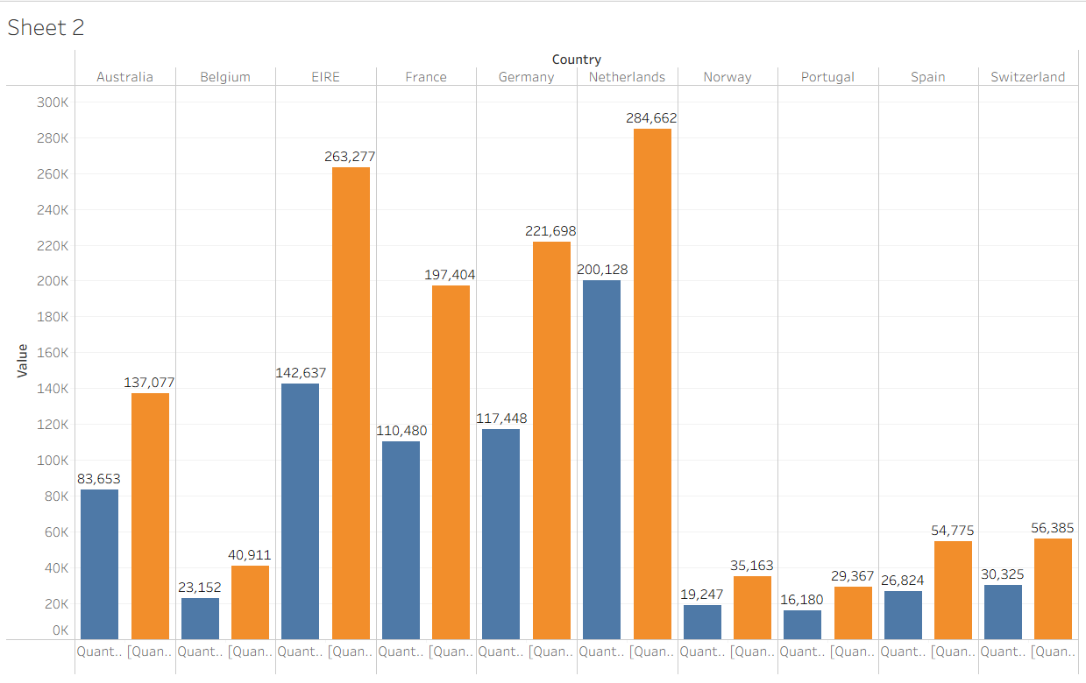
TASK 2
The top 10 countries which are generating the highest revenue and also quantity sold.
Key points:
The country UK was excluded from the top 10 countries as per the task’s instruction.
The data visualisation diagram used is side by side bar chart.

Slide 5
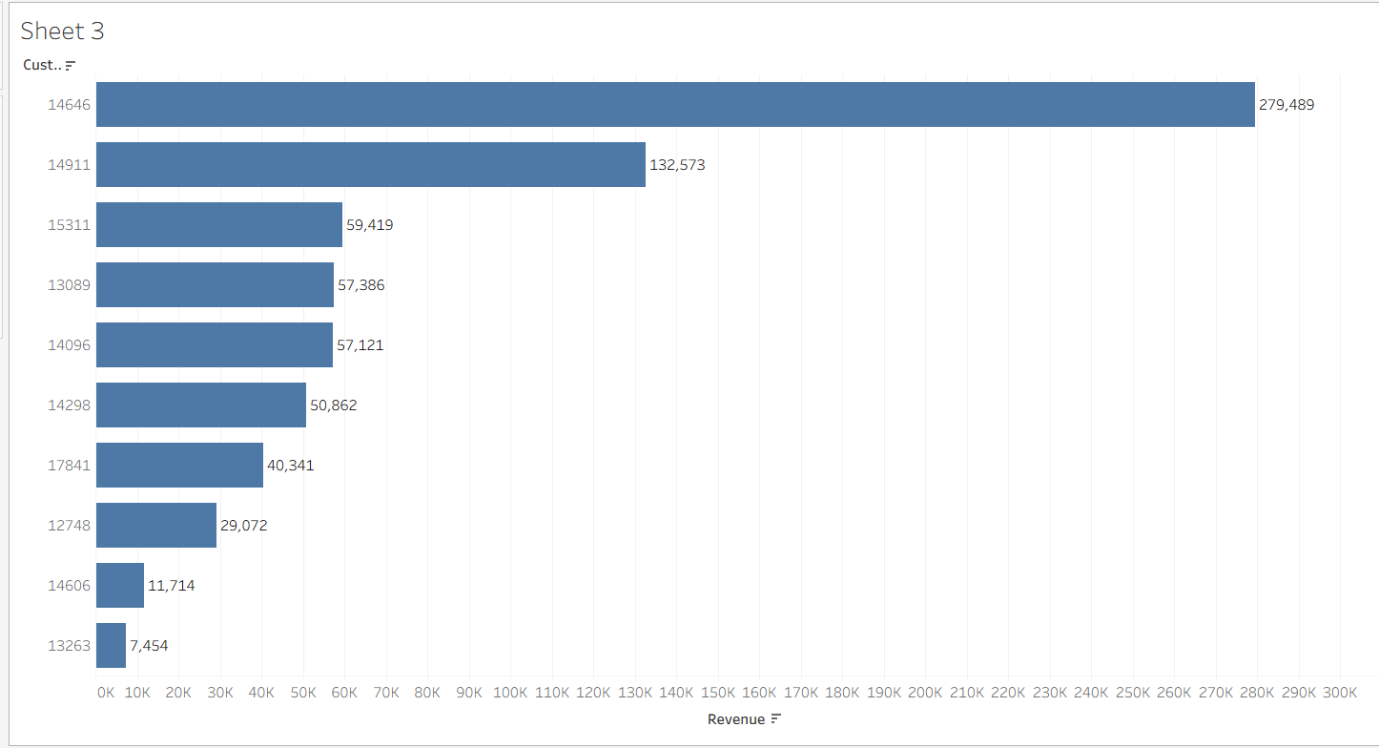
TASK 3
The task is to display the top 10 customers by revenue.The top 10 customers should be displayed in descending to ascending order.
Key points:
The data visualisation diagram used is bar chart.
The data was sorted from descending to ascending.

Slide 6
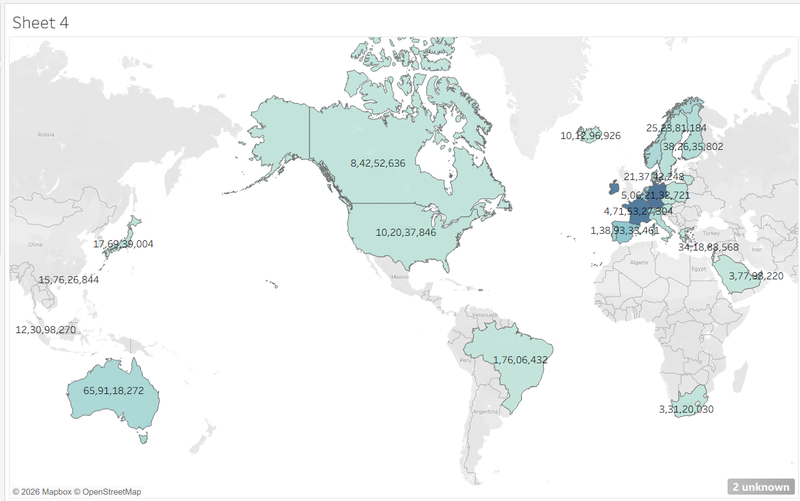
TASK 4
The task is to display the countries that have the greatest demand for their products.
Key points:
The data visualisation diagram used is map diagram.
The task instructed to exclude UK again.
The European countries showed strong product demand.

Slide 7
RECOMMENDATIONS
TASK 1
TASK 2
TASK 3
TASK 4
The months with lower revenue should be focused with discount strategies.
Special personalised tokens might boost sales too.
The countries with lower sales need exposure about the brand.
The brand marketing should be widespread in those countries.
The customer retention value is important for a brand’s trust value to increase.
The usual customers might be offered premium offers and special coupons.
The map diagram shows the countries where the brand name must get visible and popular.
The global dominance needs more wide marketing strategies.

Slide 8
Thank
you

